Slide 1
Developing research outputs management services - scoping your service
تطوير الخدمات لإدارة مخرجات البحث العلمي – تحديد نطاق خدماتك
Joy Davidson
ROMOR Basic Training Workshop/ 06/09/2017

Slide 2
الأهداف التعليمية
عند تطوير نظام لإدارة مخرجات البحث العلمي من المهم الأخذ بعين الاعتبار الفئة المستهدفة من المستفيدين، ونوع الصلاحيات المعطاة لهم، وكيفية إدارة هذه الخدمات.
سيساعد هذا العرض التقديمي على إبراز أهم القضايا الرئيسية التي يجب أخذها بعين الاعتبار عند تطوير الخدمات المقدمة.
بعد الاطلاع على هذا العرض التقديمي سيتمكن القارئ من:
تحديد نطاق خدمات إدارة ناتج البحث العلمي في مؤسسات التعليم العالي
تطوير خدمات ذات قيمة مضافة للمستودعات الرقمية
تحسين مهارات التخطيط الاستراتيجي
تطوير قيم مقدمة (عروض) خاصة بخدمات إدارة ناتج البحث العلمي

Slide 3
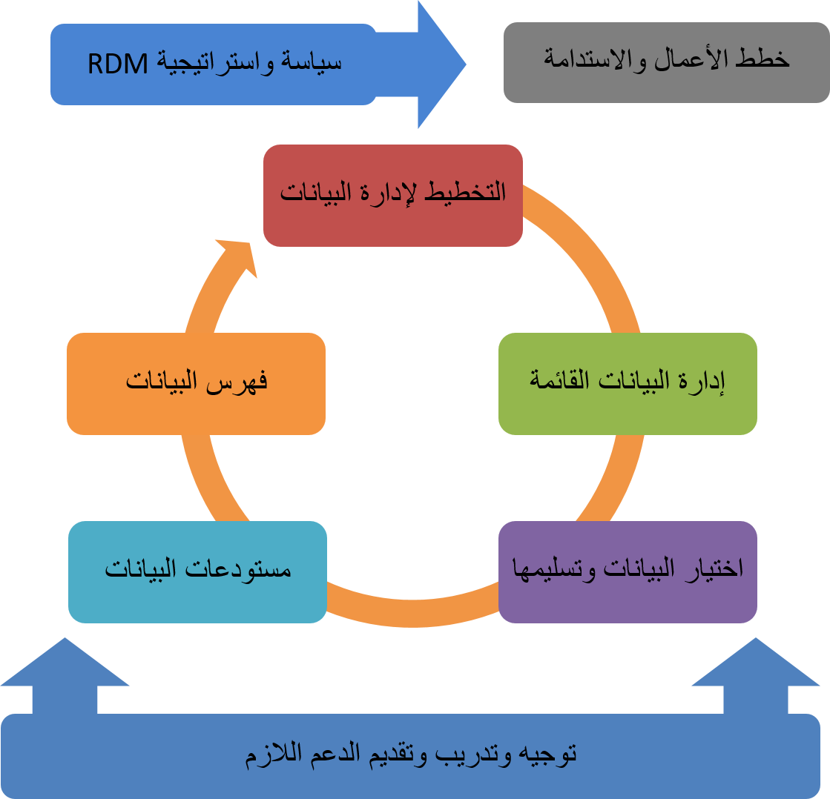
خدمات الوصول للبيانات واستخدامها والمحافظة عليها
تم عرض هذا الرسم البياني في عروض تقديمية سابقة، و يوضح هذا الرسم نطاق الخدمات التي تستطيع تقديمها للمستفيدين.
والآن سنلقي الضوء على طرق تحديد نطاق الخدمات المقدمة وتحسين مستوياتها.
http://www.dcc.ac.uk/resources/developing-rdm-services
http://www.dcc.ac.uk/resources/how-guides
Notes:
In most cases, RDM services are not a single entity but instead are spread across the institution and involve many different operational units. In this respect, it is very difficult to come up with an accurate picture of the RDM as a whole without looking at the individual RDM services to see how costs are incurred and covered across the portfolio of services.

Slide 4
بعض الأمثلة من المملكة المتحدة
سياسة واستراتيجية– 87%
تخطيط الاعمال– 13%
التخطيط لإدارة البيانات– 50%
فهرسة البيانات– 38%
إدارة البيانات القائمة– 40 %
المحافظة على البيانات– 18%
إدارة الوصول للبيانات وإعادة استخدامها– 22%
تقديم تدريب واستشارة وتنمية مهارات– 63%
Notes:
To give you an idea of RDM service provision in the UK, here is mapping of the 2015 DCC annual survey. Reflects responses from 60 institutions and is mapped to the DCC RDM services model.
Majority of UK HEIs making good progress in developing training and guidance. Longer term preservation and business case development are proving more difficult across UK HEIs. These will have an impact on training provision as well.

Slide 5
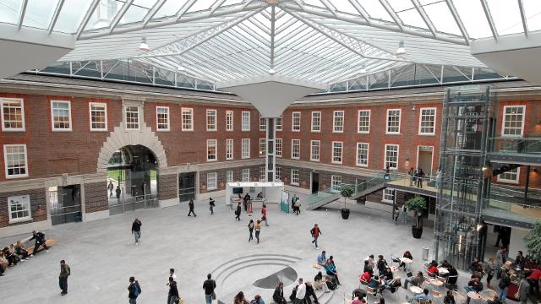
أثر هيكلية المؤسسة وحجمها ونوع إدارتها
المؤسسات الكبيرة ذو التسلسل الهرمي
تعمل ببطيء
تتطلب مستوى عالي من المناصرة والتأييد
تملك الكثير من الموارد
تملك وفورات الحجم
المؤسسات الصغيرة
تتسم بالمرونة
تملك قنوات اتصال أكثر بساطة
تملك رؤية محددة
تملك موارد أقل

Slide 6
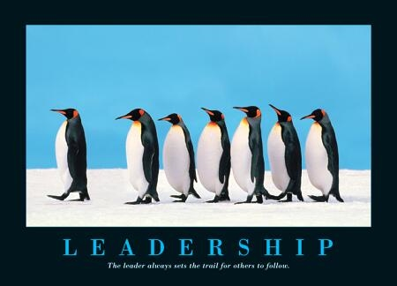
إنشاء فريق إداري طويل الأجل.
فريق مؤلف من ممثلي الدوائر التشغيلية المختلفة.
قيادة الإدارة العليا.
الاعتماد على الفريق لا على شخص معين.
إبقاء الفريق في حالة نشطة.
Image credit: http://www.executive-coaching-services.co.uk/executive-coaching/leaders.jpg
Notes:
A steering group’s overall goals may include establishing policy principles for RDM, to help communicate where it fits within the organisation’s overall mission, and to define the roles and responsibilities outlined in this guide. The steering group will also devise a strategy or roadmap for high-level approval, considering the institution’s research strategy, external policy drivers, service priorities and technology opportunities. The steering group’s overall goal will be to identify a business case to be presented to whichever organisational body can commit funding towards establishing the necessary services.
It is important to get a good mix of representation from operational units on the working group or steering committee. Representatives from the Library, Research Office, and Information Technology Services are quite common. However, it is good to ensure that you also get representation from:
Ethics Boards to ensure that plans for retaining and sharing data can be recognised within consent forms;
Data Protection/FoI to ensure that expertise on relevant exceptions to data sharing where necessary;
Legal or IPR office staff to ensure that appropriate consortium agreements can be drawn up for collaborations with industry and that appropriate licences can be identified for research output that respect any future plans for commercialisation;
Finance staff to ensure that costing RDM can be effectively addressed in grant applications.
We’d also recommend involving someone from the Archives and/or Records Management. In the UK, they have tended to be overlooked but have a great wealth of knowledge to contribute around retention scheduling, selection and appraisal.
We’ve also found that it may also be beneficial to involve members from different Schools or Faculties to ensure that disciplinary requirements are represented.
However, you may find that not all members need to be involved at all stages. You may start small to get things moving and seek to bring in other stakeholders at relevant points in the process. However, it is advisable to bring in stakeholders before pilot services are developed to ensure that they feel they are part of the process and not simply having solutions forced upon them.
Ideally a member of the senior management group responsible for research should chair the group from the start (e.g. the Vice President or Pro Vice Chancellor for Research). Indeed, it may be a good idea to get more than on senior manager’s backing as it can be quite difficult to maintain momentum of the group if the Pro-VC leaves for any reason. We have seen a few cases where this ha happened in the UK and it can derail activity quite badly if the new Pro-VC doesn’t see RDM as a key issue.

Slide 7
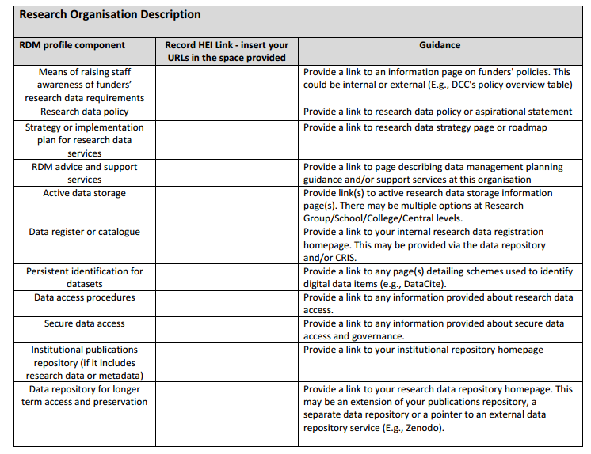
الوعي بالبنية التحتية الموجودة مسبقا
في كثير من مؤسسات التعليم العالي يتم إدراج الخدمات في عمل المؤسسة لكن ليس بالشكل الفعال
http://www.dcc.ac.uk/projects/opd-for-rdm
Notes:
It is a good idea to start by undertaking an inventory of your current RDM infrastructure. It is important to be clear here that infrastructure refers to hardware and technical solutions but also to the range of policies, guidance, training and support that are provided within an institution.
Without a clear picture of the infrastructure components already in place and additional components that need to be implemented, it is
likely that inefficiencies or duplication of effort may result when developing RDM services.
We developed a basic RDM profile worksheet and guide as part of the Jisc RDS pilot to extend the Organisational profile Document to cover RDM. The key objective of the RDS pilot project was to agree within the RDM community a list of basic RDM infrastructure components in light of RCUK’s Common Principles on Data Policy and specifically the Engineering and Physical Sciences Research Council (EPSRC) Policy Framework on Research Data and to make these infrastructure components more visible and easier to identify. The first phase of the pilot project ran from March to July 2015. A second phase of the project worked to flesh out a list of questions that HEIs can answer to get a better insight into how they are delivering specific infrastructure components. The second phase ran from September to December 2015.
By developing your own basic RDM profile, you’ll have a better understanding of what infrastructure is in place and how individual components are currently being delivered.
The basic RDM profile should not require much effort to complete. DCC have been using this as a starting point in our engagements recently and it can usually be completed in about half an hour of browsing an institution’s web site. In some cases, resources are restricted to staff only access, but the inventory helps to highlight just how easily services and infrastructure can be found – not necessarily accessed - when a potential customer is looking for it. Some quick wins can be made based on this inventory such as making services more visible and linking to them from more relevant pages that researchers might visit (e.g., not always best to include in the Library pages but rather research pages).

Slide 8
المتطلبات وترتيبها حسب الأولوية
أي متطلب يعد مستعجلاً؟
هل بالإمكان تأجيله؟
Image credit: http://goalsandachievements.co.uk/images/prioritise.jpg
Notes:
Once you’ve identified gaps, consider what is urgently needed and what can wait.

Slide 9
متطلبات لتحسين الخدمات
ظهور متطلبات جديدة
التخطيط بهدف المراجعة والتطوير
Image credit: http://cdn2.hubspot.net/hub/129398/file-699125079-jpg/images/452070249-resized-600.jpg
Notes:
But remember to monitor how needs are changing over time!

Slide 10
الاحتفاظ بمخرجات البحث العلمي

Slide 11
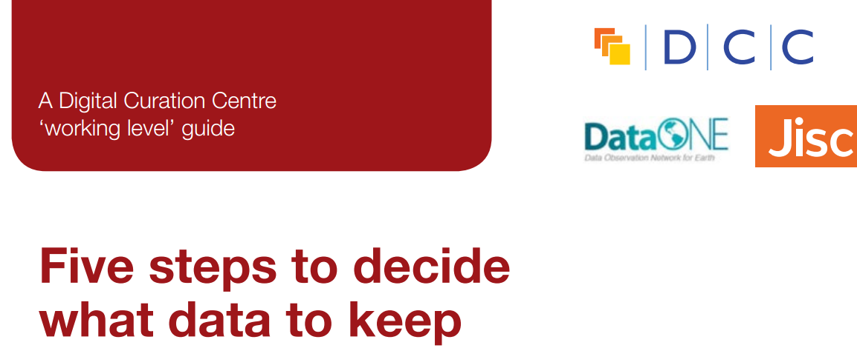
تحديد أي من المخرجات يجب الاحتفاظ بها ومكان الاحتفاظ بها
تحديد مدة الاحتفاظ بالبيانات ( من سيقوم بهذه المهمة وكيفية تطبيق الرقابة عليها)
تحديد طرق الوصول للبيانات وإدارته. تحديد الأفراد المسؤولون عن هذه المهمة
ماذا يحدث بعد انتهاء الفترة الأولية من عملية الاحتفاظ بالبيانات ؟ من يقرر تجديد الفترة؟

Slide 12
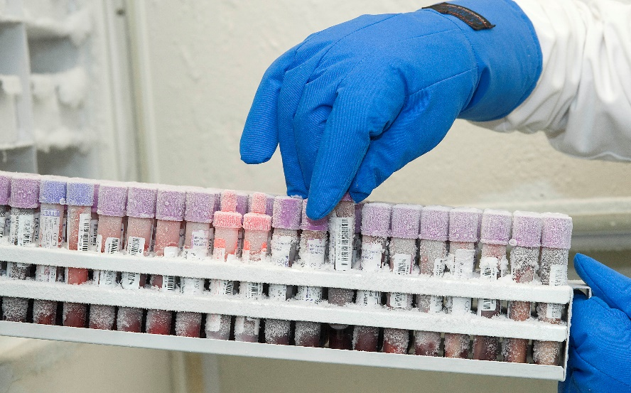
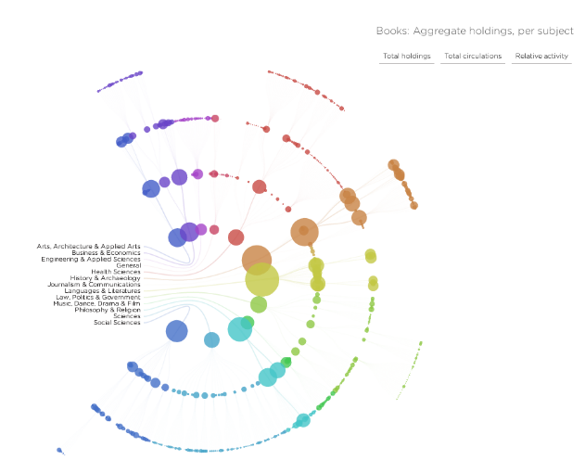
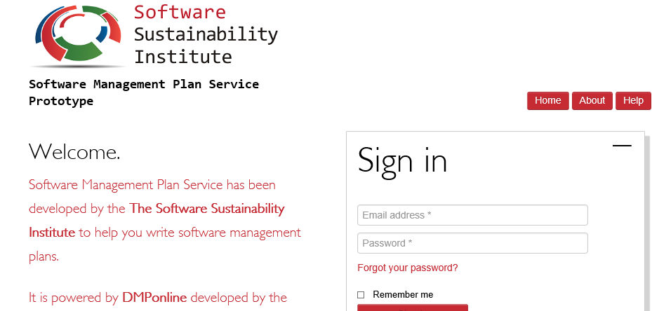
Remember to consider other outputs like physical data, software and models – how will they be linked? يجب الأخذ بعين الاعتبار المخرجات الأخرى وكيفية ربطها بالعملية مثل البيانات المادية والبرمجيات والنماذج
http://www.ukcrcexpmed.org.uk/Coventry_Warwick_CRF/PublishingImages/Tissue%20Bank%201.jpg
http://spatialinformationdesignlab.org/project_sites/library/catalog.html
https://ssi-dev.epcc.ed.ac.uk/
Notes:
Maintaining access to data for as long as necessary (usually 10+ years)
Not just the bits!
Consider Github for software and code preservation and if software is a big part of the research activity and possibly leading to a sustained tool or service, consider developing a software management plan (SSI work around DMPonline)
Also consider how links will be maintained between publications, researchers and data.

Slide 13
هل ستستخدم خدمات طرف ثالث أم ستعتمد كلياً على طاقم العمل والموارد المتوفرة في مؤسستك؟ Will you do it all in-house or use third party services?
http://arkivum.com/about-us/
https://figshare.com/
https://www.jisc.ac.uk/rd/projects/research-data-shared-service
https://researchdata.jiscinvolve.org/wp/2015/10/07/jisc-rdm-shared-service-pilot/
Notes:
Commercial products starting to emerge
Archivematica
Arkivum
Long term – possibly forever (remember the EPSRC example!)
Not just the bits though – software used to analyse and render data, algorthims used, all part of research reproducibility
Competition as more produce emerge – prices can go down
Know what you need before talking to vendors –speed of access to help determine storage options -worth doing your homework

Slide 14
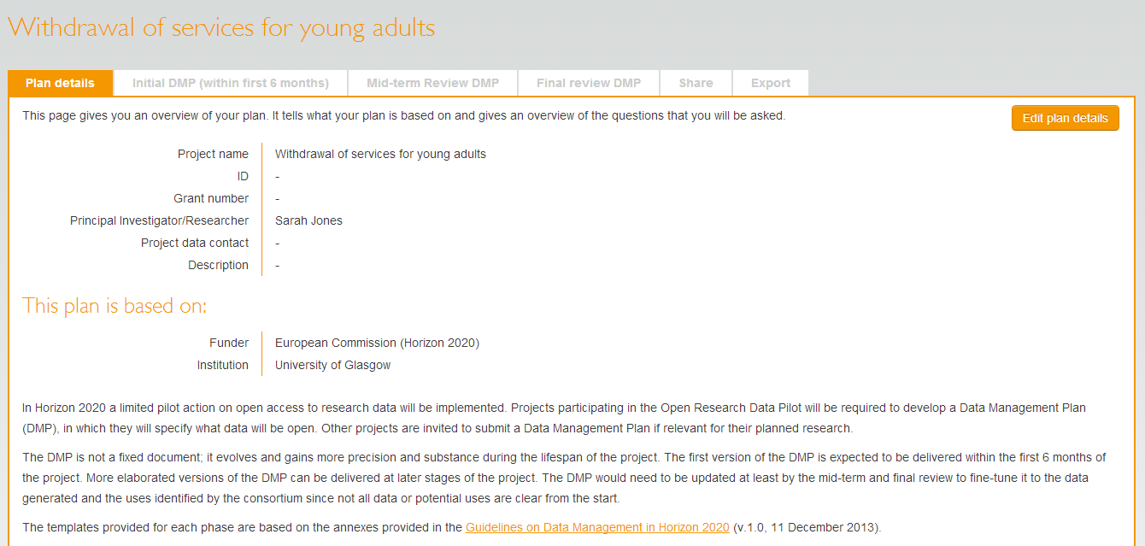
متى و كيف ستشارك في البحوث العلمية القائمة؟ ومن سيقوم بهذا الأمر؟ How will you engage with research teams during the active phase of research? When, how often, who will do it?
Notes:
Encourage researchers to review their data management plan at least as often as they provide updates to their funder. Consider whether your institutional policy will require researchers to make a final phase DMP public via your institutional repository and link it to you publication and data set. Get them to consider publishing the final version DMP as a data paper – increasing number of peer reviewed data journals emerging. Good to get credit for their efforts!
Most institutions are working with researchers to determine what data needs to be retained at the end of a project to enable reproducibility and to identify any other data that may have longer term value. This can be time consuming as noted earlier. In some cases many hours may be needed to work backwards from publications to data (processes, raw, etc) and considering any software that may need to be retained as well. Up to date DMPs can assist with selection and appraisal decisions and speed up the process significantly and ensure all data that needs to be retained is captured.

Slide 15
استكشاف البيانات والوصول إليها وإعادة استخدامها Discovery, access and reuse

Slide 16
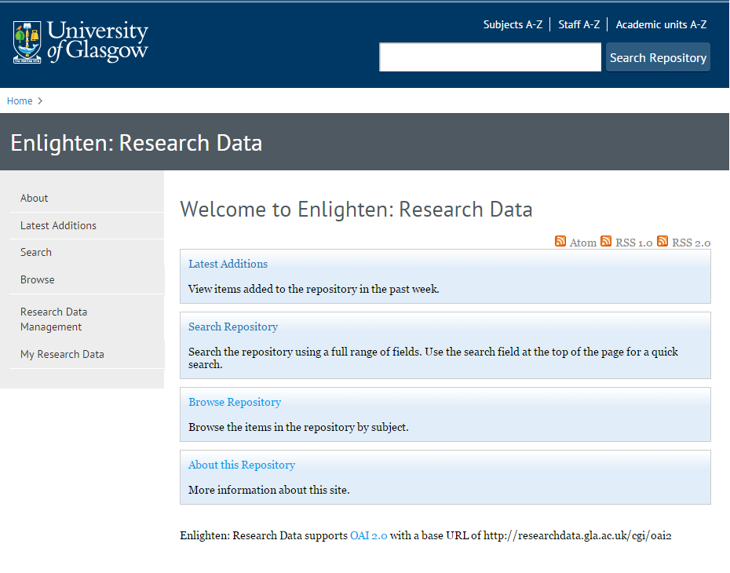
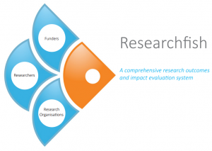
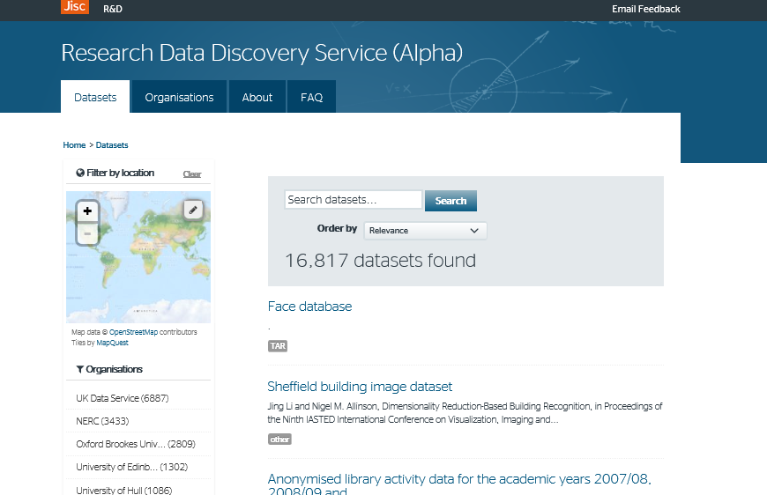
How will you make your outputs discoverable? ما هي خططك لجعل البيانات قابلة للاكتشاف من قبل المستخدمين ؟
http://researchdata.gla.ac.uk/
http://gtr.rcuk.ac.uk/
https://www.researchfish.com/
http://ckan.data.alpha.jisc.ac.uk/dataset
Notes:
Data reuse depends upon its ability to be found and understood.
Make sure important information can be captured and reused very early on in the lifecycle, For instance, grant information included in research information systems can be repurposed later in the lifecycle by publications and data repositories and ultimately by national aggregators and funders’ outputs systems. Aim to user metadata standards to enable this information to be pushed and pulled between systems. Highlights the importance of applying unique and persistent identifiers Enter one and use many times (CASRAI mantra). Requires adherence to metadata standards and ongoing efforts to enable interoperability among system developers.
Once data has been accessioned into an internal or external data repository, how will usage be monitored? How will you be able to track usage in external systems?
For either internal or external systems, usage will need to be defined as well (download, citation, other?) Most likely monitoring will be automatically handled so this again draws us back to the importance of applying unique and persistent identifiers to research outputs and recommending a preferred citation for datasets. This will make tracking much easier and reporting more straightforward (e.g., for specific funders, for specific researchers, for specific projects)
If monitoring usage, will you use these to help reappraise data? Reuse metrics in one discipline may be far greater than for others so may not be able to have a one size fits all (relate metrics to discipline specific norms)
If the institution is the owner of the data (be clear on this in your policies!), you may not need to inform anyone else of any future decisions around retention. However, it could be good practice to notify content creators of any decisions to remove data from preservation storage so that they may find alternative storage options. Many researchers build upon work for their entire careers so even if it isn’t being widely used by others, it will be of immense importance to their careers.
Also consider how you might handle staff moving to new institutions. They may want to take their data. If the institution owns the data and wishes to retain it, this is where ORCIDs can be incredibly useful. Authors can remain linked to outputs even if their location of work changes. Again, this highlights the value in using standard identifiers.
Considerations:
Defining a set of metadata to publish (See: DataCite, OpenAIRE, RDDS, RADAR)
Reducing duplication of effort by harvesting information from other systems
Linking to other outputs

Slide 17
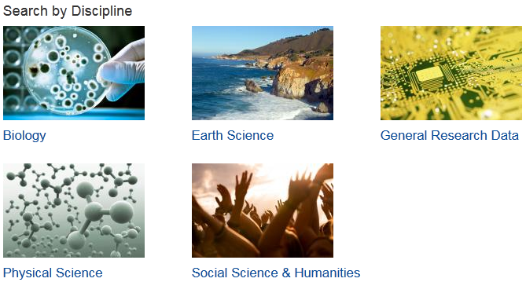
كيف ستفند وتصف المخرجات التي تملكها؟ How should you describe your outputs?
http://www.dcc.ac.uk/resources/metadata-standards
Notes:
To give your data the best chance of being reused, make sure potential reusers can understand it. Use an existing standard whenever possible (almost always!)
DCC’s metadata catalogue can help you find discipline specific standards to use. But remember that interdisciplinarity is a key objective for many institutions and funders are also very keen on this aspect. So, in addition to using disciplinary standards for describing data, consider any information that might be needed for other communities to make sense of the data.
Supporting researchers to develop lay summaries is a great idea. Not only will this help to make their data clear to potential reusers from any discipline, a lay summary is also great to provide to your institution’s communication team for engaging with policy makers and the media.

Slide 18
التحديات العملية المتعلقة بالوصول إلى البيانات Practical issues relating to access
How will data access be governed – who will make decisions regarding access? كيف ستتم إدارة عملية الوصول إلى البيانات؟ من سيتخذ القرارات المتعلقة بالوصول؟
How will a description of sensitive data holdings be found? كيف سيجد المستخدم الوصف الخاص بالبيانات ذات المضمون الحساس
Do you need a safe haven to provide secure access if requests come in? هل تستطيع تأمين عمليات دخول آمنة؟
Notes:
Open data that can be found and accessed using web interface will not require any additional manual effort in most cases. However, for any retained data that is sensitive – either for commercial reasons or due to the personal nature of the information – will need some mechanism in place where queries requiring access can be received, logged and dealt with.
The formation of a data access group or committee will be necessary to ensure that applications for data access can be assessed and appropriate means of facilitating access can be agreed. In some cases, there may be a safe haven where this can be handled virtually but in most cases this may require agreements and data transfer or in some cases only providing access on site within a secure environment.
To make the burden on data access committee making decisions, as much information about consent and consortium agreements in place – and for how long – is essential. Depends upon good data management planning and documentation.

Slide 19
تيسير معالجة البيانات ذات المضمون الحساس منذ البداية- من سيشارك في هذه الخطوة؟ Make dealing with sensitive data easier from the start – who should be involved?
PI/researcher الباحثون
Data repository المستودعات الرقمية
Support staff موظفي الدعم
Research participants المنخرطون في البحوث العلمية
Commercial partners شركاء الأعمال
Secondary data user مستهلك البيانات الثانوي
Notes:
During the early stage of the research lifecycle, it is essential to identify any sensitivity issues – either through commercial
While the researchers themselves will have a key role to play in sharing data, it is important to note that they are not the only stakeholders involved in the process.
Repository – how will data be made visible?
Support staff – e.g., Library staff to help describe data to make it easier to find and understand.
Research participants – informed consent is required (come back to this later)
Secondary user – when sharing data, researchers can ask reusers to tick that they accept terms and conditions regarding fair use
Commercial – identify what can and can’t be shared and make this explicit.

Slide 20
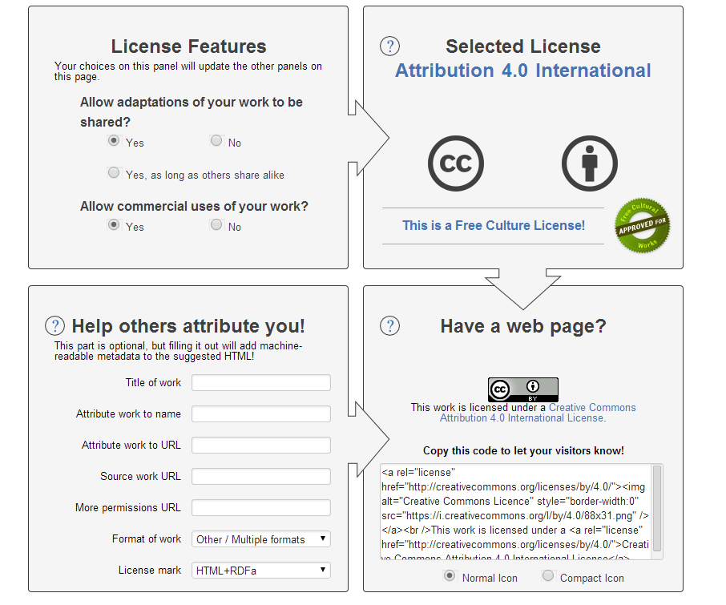
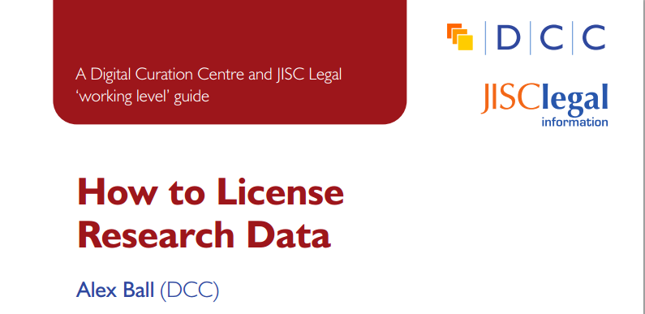
يجب أن تكون واضحاً في تحديد من سيكون قادراً على استخدام البيانات – الترخيص Be clear about who can use data – apply a licence
www.dcc.ac.uk/resources/how-guides/license-research-data
http://creativecommons.org/choose/

Slide 21
إعطاء توجيهات تتعلق بكيفية توثيق المخرجات لتيسير الرقابة عليها
Provide guidance on how outputs should be cited to make monitoring use easier.
هل سيتم توثيقها بشكل آلي بواسطة OAIR
هل سيكون توثيقها شبه آلي؟
هل سيتم توثيقها بشكل يدوي؟
من سيقوم بهذه العملية؟

Slide 22
التدريب والتوجيه
من هم جمهورك المستهدف من التدريب وما هي الطرق المتبعة لإتمام التدريب (طلاب، موظفي الدعم في الدوائر المختلفة، الخ)
مدة التدريب والمنهجية المتبعة -لقاءات وجاهية، لقاءات افتراضية، استخدام موارد من مصادر خارجية مثل FOSTER, MANTRA
من سيطبق التدريب وعدد المرات التي سيُقدم التدريب فيها؟ وما هي التكاليف المترتبة على التدريب؟
Notes:
One of the key points connecting researchers with services are institutional RDM guidance web-pages.

Slide 23
قنوات الاتصال والتواصل Channels and communication
Technical considerations اعتبارات تقنية
What systems need to integrate ما هي الأنظمة التي تحتاج إلى دمج؟
How can choice of system promote engagement and information flow كيف سيؤثر اختيار نوع النظام المستخدم على تعزيز المشاركة وتدفق المعلومات؟
Cultural considerations اعتبارات ثقافية
Who needs to communicate من الذي يحتاج الى إنشاء تواصل معه؟
What structures/workflows need to be in place ما هي الهيكلية أو نظام العمل الذي يجب اتباعه؟
Notes:
When we are talking about channels it helps to think both about what stakeholders or systems need to be connected and how systems can be designed to promote engagement with these channels.
Engaging researchers with new services
> Eg Repositories which often take time to populate
Communication between departments
> Eg the disconnect between library-based RDM services and RO DMP advice

Slide 24
استدامة الخدمات والبنية التحتية Sustaining services and infrastructure

Slide 25
تحديد المقاييس Defining metrics
What should you measure?
ما الذي يجب قياسه؟
How will you measure it?
كيف سيتم قياسه
How often will data be collected?
كم مرة سيتم جمع البيانات فيها؟
Who will do it? من سيقوم بهذا الأمر؟
http://blog.kksmarts.com/wp-content/uploads/2013/05/tape_measuring_success_6539.jpg

Slide 26
اكتساب ذكاء تجاري Gaining business intelligence
http://lib-ldiv.lancs.ac.uk:8080/dmaonline/dashboard/index.html#/

Slide 27
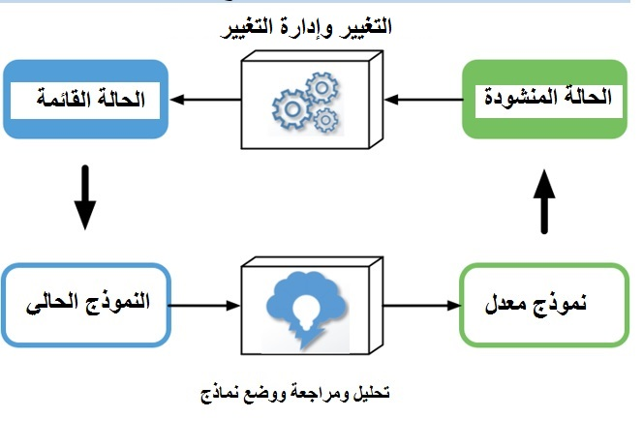
كيفية استدامة نموذج العمل الخاص بك Sustainability of your business model
http://www.curationexchange.org/
Notes:
Keep in mind that the business model you use now is unlikely to remain a perfect fit for your organisation over the longer term. Changes in legislation, evolving stakeholder needs, and potential new revenue streams necessitate the ongoing evaluation and refinement of your business model to ensure that your operations remain viable over time.
It is important to set aside time and effort to actively monitor your business model. By doing so you put yourself in a better position both to respond in a more agile manner to evolving organisational context and stakeholder needs, and to reassess how you deliver services and activities in the face of evolving resources and cost drivers.

Slide 28
ملخص Summing up
Understand your organisational context الوعي بالبيئة التنظيمية الخاصة بمؤسستك
Talk to users! Gather and refine requirements over time تواصل مع المستخدمين للحصول على تغذية راجعة ولتطوير العمل وفقاً لمتطلباتهم
Balance your level of service with resources available وازن بين الخدمات والموارد المتاحة
Re-assess scope as you roll out pilot services - learn through your own experience and from your peers تعلم من تجاربك وتجارب الآخرين، وأعد تقييم نطاق عملك عبر استخدام خدمات تجريبية
Plan to collect data bout costs and effort required and revise your business model over time راجع نموذج عملك بشكل مستمر واجمع البيانات المتعلقة بالتكاليف والجهود المطلوبة لإنجاز المهمات بالشكل السليم

Slide 29
تمرين جماعي Group exercise
In your institutional groups, please discuss one of the RDM Service Model components that you currently - or will – provide in relation to your OAIR. ضمن فرق العمل في مؤسستك، ناقش إحدى مكونات نموذج «خدمات إدارة البيانات البحثية»
1) What is the value proposition of this service? ما هي القيمة المقدمة في هذه الخدمات؟
2) Who does or will realise the benefits of the service? من هم المستفيدون من هذه الخدمة؟
Researchers باحثون
Senior Management الإدارة العليا
Funding bodies الجهات الممولة
All of the above? جميع ما ذكر سابقا؟

