Slide 1
تطوير السياسات اللازمة لدعم إدارة مخرجات البحث العلمي
Joy Davidson
ROMOR Basic Training Workshop/ 06/09/2017

Slide 2
الأهداف التعليمية
من خلال هذا العرض التقديمي سيتمكن المشاركون من تحديد السياسات المطلوب تطويرها في مؤسساتهم لدعم إدارة مخرجات البحث العلمي.
كما سيتمكن المشاركون من:
مراجعة وتدقيق السياسات التي تتبعها مؤسساتهم و تحديد التعديلات اللازمة أو وضع سياسات جديدة لدعم إدارة مخرجات البحث العلمي.
التعرف على الآثار العملية الناتجة من تطبيق السياسات الداعمة والتأكد من الالتزام بها.

Slide 3
تسلسل العرض التقديمي Structure of session
تحديد نطاق السياسات اللازمة لدعم إدارة مخرجات البحث العلمي وتطبيقها والإشراف عليها.
تمرين جماعي: استعراض بعض من الأمثلة على السياسات الداعمة.
آراء المشاركون.

Slide 4
Data Management Planning
Data Management Planning
إطار إدارة البيانات البحثية

Slide 5
سياسة الجهات المانحة
Funders’ mandates
“Publicly funded research data are a public good, produced in the public interest, which should be made openly available with as few restrictions as possible in a timely and responsible manner that does not harm intellectual property.”
«تُعتبر البيانات البحثية الممولة من القطاع العام سلعة عامة، بحيث تُنتج بهدف المصلحة العامة ، وينبغي توفيرها بشكل مفتوح للمستخدمين، مع أقل قدر ممكن من القيود
وفي الوقت المناسب على نحو مسؤول لا يتعدى على الملكية الفكرية»
مبادئ RCUK العامة لسياسة البيانات
RCUK Common Principles on Data Policy
http://www.rcuk.ac.uk/research/Pages/DataPolicy.aspx

Slide 6
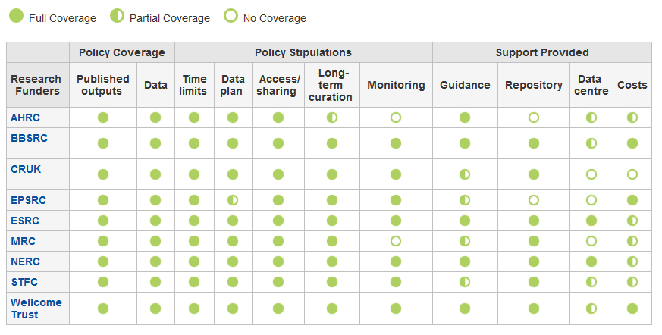
DCC جدول سياسات
www.dcc.ac.uk/resources/policy-and-legal/ overview-funders-data-policies

Slide 7
في نهاية المطاف تتوقع الجهات المانحة التالي:
timely release of data
once patents are filed or on (acceptance for) publication
نشر البيانات بالوقت المناسب
بمجرد إيداع براءات الاختراع أوفي خضم نشرها (أو قبولها للنشر)
open data sharing
minimal or no restrictions if possible
مشاركة البيانات بشكل مفتوح
الحد الأدنى من القيود أو عدم وجودها إذا كان ذلك ممكنا
preservation of data
typically 5-10+ years if of long-term value
حفظ البيانات
حفظ البيانات لمدة تتراوح من 5 إلى 10 سنوات أو أكثر إذا كان محتواها ذات قيمة طويلة الاجل
بإمكانك الاطلاع على مبادئ RCUK العامة لسياسة البيانات
See the RCUK Common Principles on Data Policy:
www.rcuk.ac.uk/research/Pages/DataPolicy.aspx

Slide 8
“Research organisations will ensure that effective data curation is provided throughout the full data lifecycle, with ‘data curation’ and ‘data lifecycle’ being as defined by the Digital Curation Centre. The full range of responsibilities associated with data curation over the data lifecycle will be clearly allocated...
«ستعمل المنظمات البحثية على معالجة البيانات بشكل فعال، على مدى دورة حياة البيانات ، ووفقاً لتعريف مركز التنظيم الرقمي لمفهومي " معالجة البيانات "و" دورة حياة البيانات"، وسيتم تحديد المسؤوليات المتعلقة بمعالجة البيانات على مدى دورة حياة البيانات وتحديد نطاق هذه المسؤوليات بشكل واضح.»
المسؤولية المؤسسية
www.epsrc.ac.uk/about/standards/researchdata/Pages/expectations.aspx

Slide 9
“Data sets are becoming the new instruments of science”
«أصبحت مجموعة البيانات الأدوات الجديدة للعلوم»
Dan Atkins, University of Michigan
دان اتكينز، جامعة ميتشغن
Notes:
But also, data driven research becoming the norm in all disciplines. To be competitive in this new research landscape, researchers need access to good quality data and infrastructure. At the moment, worrying statistics on reproducibility. Good institutional policies can help to promote good research practice but also require support for implementation.

Slide 10
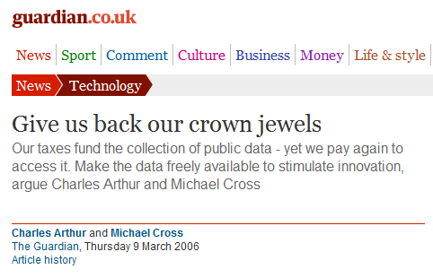
Research data: institutional crown jewels?
البيانات البحثية: هل تعتبر من أكثر المقتنيات قيمة للمؤسسات؟
http://www.flickr.com/photos/lifes__too_short__to__drink__cheap__wine/4754234186/
Notes:
HEIs are wary of giving up the rights to these assets to publishers as we did with publications. E.g., we don’t want to have to pay twice to access our own research and the benefit from it. Polcies can help to avoid giving over rights to external entities.

Slide 11
Data Management Planning
Data Management Planning
تطوير السياسات المتعلقة بالبيانات البحثية وتطبيقها
Developing and Implementing a Research Data Policy
Notes:
So, a bit about the landscape, but what do you need to bear in mind when developing a research data policy?

Slide 12
يجب أن تكون واضحاً بخصوص أي من الأنشطة سيتم تضمينها في سياسة المؤسسة:
«الإدارة الفعالة للبيانات وتقييمها على مدى دورة حياة الاهتمامات العلمية والأكاديمية».
تعد البيانات مهمة لكونها تعتبر قاعدة الأدلة للاستنتاجات العلمية.
تعتبر إدارة البيانات من الممارسات السليمة للبحث العلمي.
Notes:
Firstly, any policy should be very clear about what they mean by terms such as research data management and curation.
The DCC definition implies adding value to data selected for retention. Adding value requires a commitment of time and resource.
Universities should be clear that RDM and curation are not just about storage. But also about support services. This must be reflected in any policies that are developed.

Slide 13
يجب تحديد ماهية البيانات البحثية وتعريفها إذ أن نطاقها واسع ويشمل العديد من الأمور وذلك عند إدراجها في سياسة المؤسسة
نماذج وتصورات.
قاعدة بيانات.
البيانات الأولية (حُصل عليها من خلال الأدوات).
البيانات المنقحة (مجهولة المصدر).
مدونات، تغريدات.
صور.
ملفات صوتية.
أو أي شيء ينتجه الباحثون
Notes:
Institutions need to be prepared to deal with a wide range of data types. Anything that researchers are working with might potentially need to be retained.
Policies should be explicit about what research data are covered by the policy. Just for funded research activity? All research?
What about PhD students and thesis work?
At a minimum, institutions should ensure that research data required to validate published research findings are retained in line with funders’ mandates.
It is a good idea to work with disciplines to determine what level of data would be required – raw data, algorithms, visualisations?

Slide 14
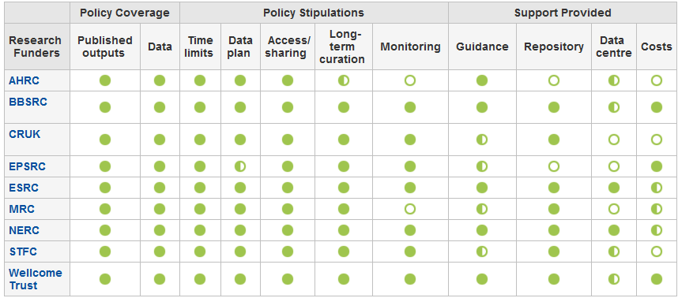
سياسات الجهات المانحة الخاصة بالبيانات Funders’ data policies
http://www.dcc.ac.uk/resources/policy-and-legal/overview-funders-data-policies
Notes:
Be aware of funders’ policies when developing your own.
Most funders’ require data to be retained for 10+ years. In the case of EPSRC, they expect data to be kept for 10 years after it was last accessed so , institutions may need to retain data in perpetuity!
The DCC’s at-a-glance summary of funders’ data management and sharing policies is a good resource for anyone who needs to understand funders’ RDM and curation requirements.

Slide 15
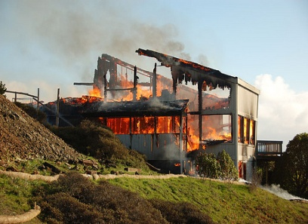
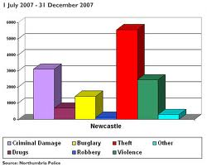
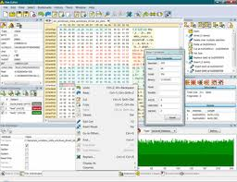
لا يوجد عواقب فقط وإنما مكافآت أيضاً
الوقاية من فقدان البيانات
التمكن من إثبات صحة النتائج
الحصول على نسبة اقتباس أعلى (9-30%) (Piwowar H. and Vision T.J 2013 , https://peerj.com/preprints/1.pdf)
إجراء بحوث بشكل أسهل
Notes:
Policies are useful to help shape services and identify priorities within an institution, but they aren’t always the best way to motivate researchers.
So, in any activities you undertake to promote institutional RDM policy development, be sure to stress the potential benefits to researchers.

Slide 16
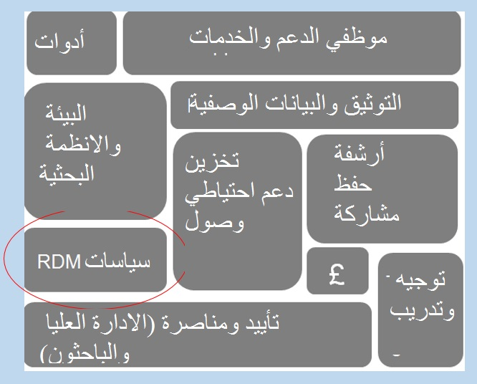
خدمة البيانات البحثية وعناصرها
Notes:
The policy along is not enough!
Policies are just one part of a successful research data management service.
Various other components need to be addressed as well to ensure that researchers can – and want to – adhere to the policies. Sustaining the service through core funding will crucial.
Ensuring there is adequate support to ensure compliance to the policy is feasible and can be monitored will be vital.
To do this, senior management support – and more importantly funds – are crucial .

Slide 17
أمثلة على سياسات البيانات البحثية
«بيان الالتزام» بنية تحتية - سياسة
تتبع أسلوب الامتثال القانوني،
تحتوي على دليل مفيد ويمكن استخدامه كملحق
«الوصايا العشر»
وعود وطموحات مشتركة
مبني علىEdin مع بعض من الإضافات
مرجعية RCUK Code+ إجراءات ودعم
www.dcc.ac.uk/resources/policy-and-legal/institutional-data-policies
Notes:
You don’t need to start from scratch. There are a lot of examples out there that you can reuse. Lots of different styles as well.
Top tip – draw upon institutional policies you already have in place (data protection/FoI, research conduct, etc.)
The University of Edinburgh’s policy is aspirational as they know there’s some way to go to make it a reality.
The University of Hertfordshire has RDM requirements as part of a wider data management policy. The language/style is more legal, however an appendix provides much more practical guidance on data management.
The University of Northampton reiterates the RCUK Code as its guiding principle and usefully provides guidance on procedures and support to explain how the policy should be implemented.
The DCC has been collecting examples of policies and there are links from the DCC website.
You’ll have a chance to consider the right style of policy for RTU later this morning.

Slide 18
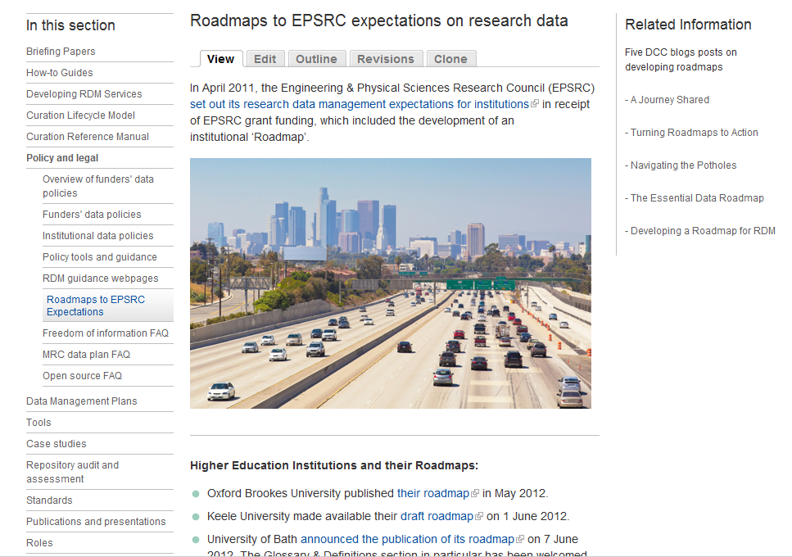
خريطة الطريق الخاصة بالمؤسسة
http://www.dcc.ac.uk/resources/policy-and-legal/epsrc-institutional-roadmaps

Slide 19
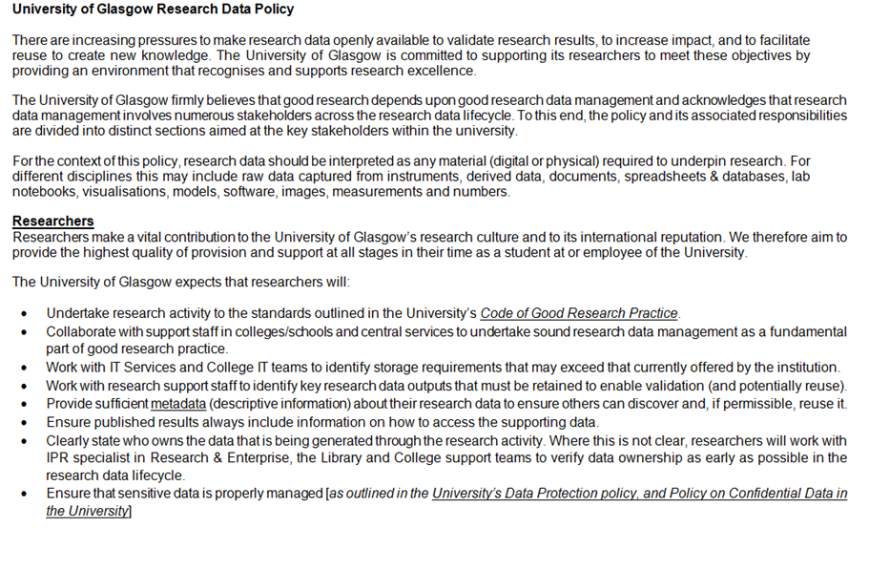
سياسة البيانات البحثية لجامعة جلاسكو
http://www.gla.ac.uk/services/datamanagement/rdm-at-gu
Notes:
An example of what we are trying to do locally at the University of Glasgow.
Our policy breaks up the various expectations across the stakeholders and provides some views on University support commitment.
This shows the expectations for Researchers, College/School and Central support services.

Slide 20
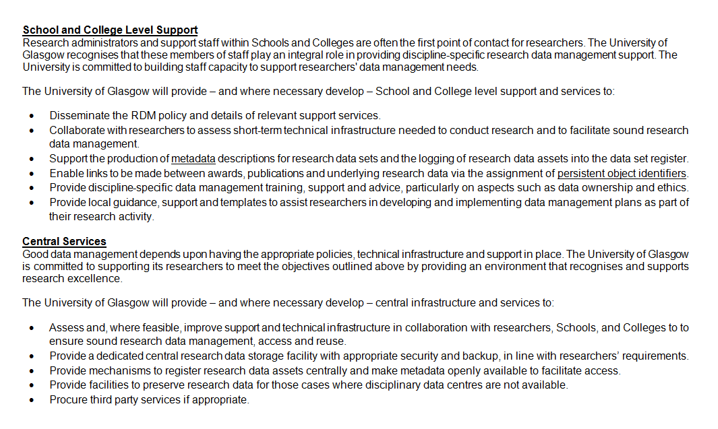
سياسة البيانات البحثية لجامعة جلاسكو
Notes:
Top tip – it is a good idea to develop and refine the policy iteratively with consultation from stakeholders rather than having a very small group develop and ratify the policy and then roll it out.
The GU policy is draft and will be developed iteratively with the stakeholders to ensure we come up with something that most people can live - and hopefully - comply with.

Slide 21
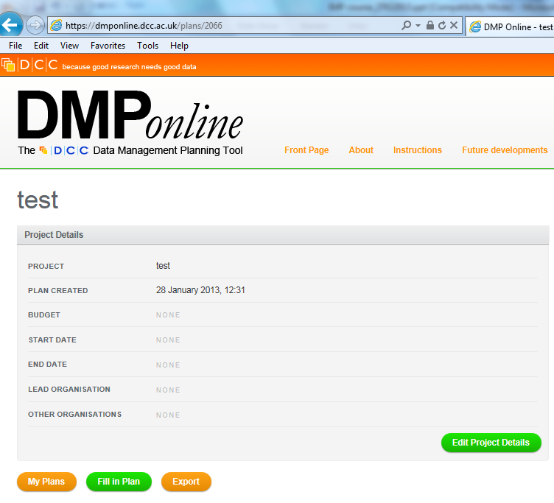
التخطيط لإدارة البيانات
Notes:
How will data management plans fit in with your policy? All research, funded research?
Where will data management plans be kept? Grants team for pre-award, repository for post-award, PI for in-project?
The DCC has developed DMPonline which provides funder-specific templates for researchers completing data management plans at the grant stage.
A number of UK HEIs are developing institutional templates that include local policies and guidance. DCC are happy to work with institutions who wish to develop their own templates.

Slide 22
مرحلة البحث الفعلية - صندوق إيداع أكاديمي
Lab notebooks سجل أولي للملاحظات البحثية
Workflows (Taverna)سير العمل
http://libraryblogs.is.ed.ac.uk/jiscdatavault/
Piloted at Lincoln & Edinburgh
http://tiny.cc/owncloud-pilot
www.dataflow.ox.ac.uk
Notes:
Policies should also consider aspects such as how researchers can work during the active phase of the research project.
Try to make it easy!
DataFlow at Oxford aims to make the transition of data between the university drives to longer-term storage a one click process.
Hertfordshire also provide a standard folder structure to researchers to use in new projects to help organise their data during the active phase.
Most researchers work using collaborative tools such as DropBox and Google Docs. Janet are offering some more secure cloud-based spaces to help researchers.

Slide 23
اختيار البيانات التي تود حفظها
أسئلة رئيسية
ما هي البيانات التي يجب حفظها؟ (للتحقق من صحتها، الخ).
ما هي البيانات التي لا يجب حفظها؟ (بيانات شخصية، الخ).
هل من المجدي الاحتفاظ بالبيانات ؟ التكاليف والفوائد.
أين ستحفظ البيانات؟
من سيتكبد بالتكاليف؟
Notes:
23
Key questions:
What data must be kept? (for validation, etc)
What must not be kept? (e.g. personal data)
Is it worth keeping the data? – cost/benefits
Where will the data be kept?
Who pays?

Slide 24
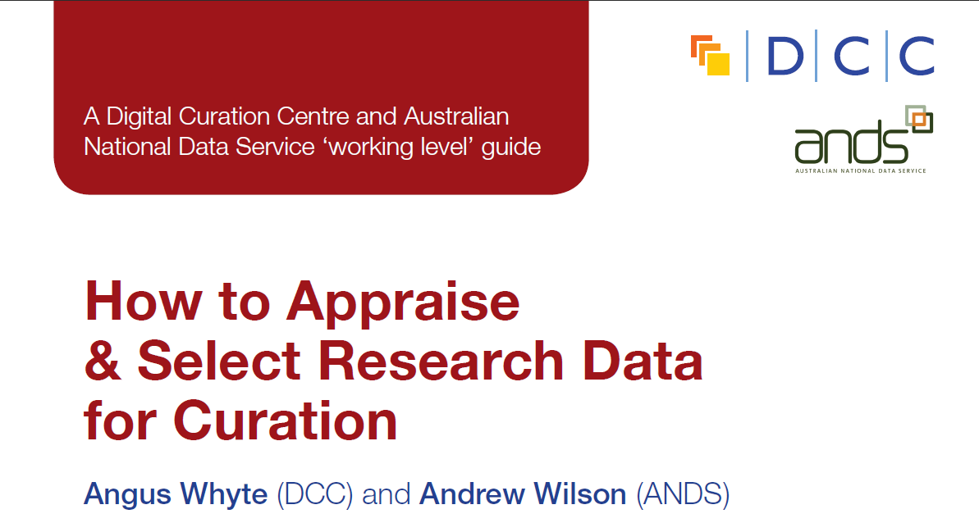
اختيار وتقييم فعال على مدى دورة الحياة الكاملة للبيانات
http://www.dcc.ac.uk/resources/how-guides
http://www.nerc.ac.uk/research/sites/data/documents/data-value-checklist.pdf
Notes:
Researchers and support staff might need guidance on what should be kept.
The NERC data value checklist is useful at the pre-award stage to identify any otuputs that may need to be retained. The checklist is also used to assess quality, integrity and originality of the data at the point of deposit into a data centre once the project has been completed.
Once the project has been completed, the DCC How-to select and appraise research data might be useful in identifying data that warrants longer-term retention and the associated investment .

Slide 25
الأرشفة-مستودعات البيانات المؤسسية
ليس الهدف منها استبدال مجموعة البيانات المحلية الوطنية الموجودة مسبقاً أو غيرها
يجب أن نقر بأننا بحاجة إلى العمل ضمن بيئة مختلطة
http://datashare.is.ed.ac.uk
Essex-RDR و
Southampton في DataPool
www.dspace.cam.ac.uk/
https://databank.ora.ox.ac.uk
Notes:
Policies should include details on expectations regarding data cataloguing and deposit at the end of the project.
A number of UK HEIs are developing and testing data repositories and data catalogues to record data that is perhaps held outside the University (e.g., data centres).
A few institutions already run data repositories e.g. Edinburgh and Cambridge (both DSpace) . Others are piloting them e.g. Essex and Southampton (doing extensions to existing ePrints repositories as part of JISC MRD02 programme) and Databank at Oxford. Lincoln is piloting the use of CKAN.
Key thing is that none of these services intend to replace established data services. Where there are more appropriate disciplinary data centres, for example, the data should be submitted there.

Slide 26
الأرشفة- المراكز الخارجية للبيانات
قواعد بيانات منظمة
مراكز البيانات للجهات الممولة للأبحاث
سجلات مراكز البيانات الدولية
مبادرات مجتمعية وتخصصية
Notes:
There are many external services – dedicated data centres supported by research funders and various structured databases and community initiatives.
Where funders have data centres, they generally expect data to be deposited at the end of the project. You don’t need to duplicate it locally. But, you will want to maintain a link between publications, grants and data.
Researchers may need support at the grant application stage to identify a possible home for their data if it will not be held within the instituion or by a funders’ data centre. Databib and Re3data can help you finds suitable repositories.

Slide 27
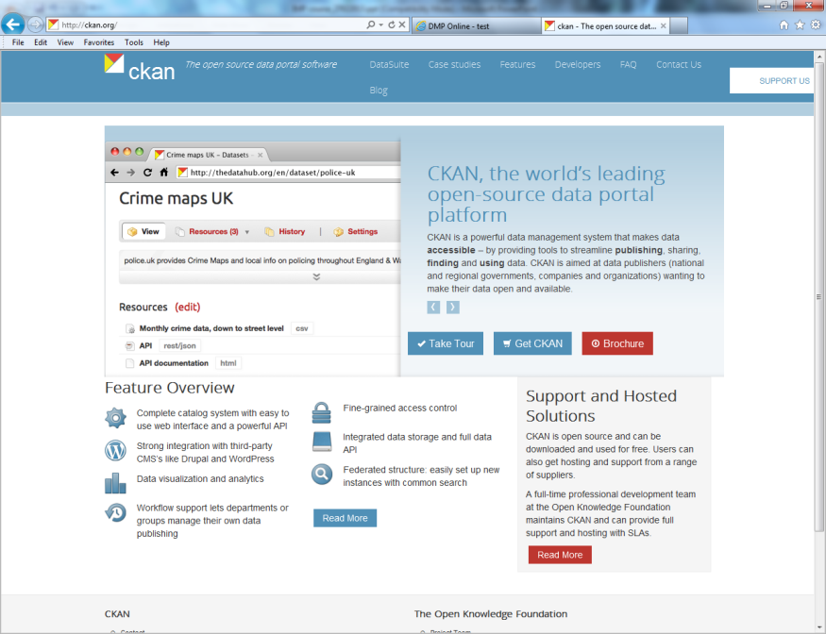
فهرسة البيانات ( البحث عن البيانات)
JISC و DCC تخطيط
تنسيق وطني
Notes:
Many institutions are developing data catalogues to capture details of research data that has been generated through university research activity. These catalogues generally contain metadata about the data rather than the data itself.
A pertinent project to look at is C4D, which is developing an extension to the Cerif standard to record information on research data.
Jisc and DCC are developing a national research data registry which will harvest metadata from the institutional catalogues to make data more visible at the national level. We are using Research Data Australia – a discovery service for research data from Australian universities supported by ANDS – as the model for this pilot service.

Slide 28
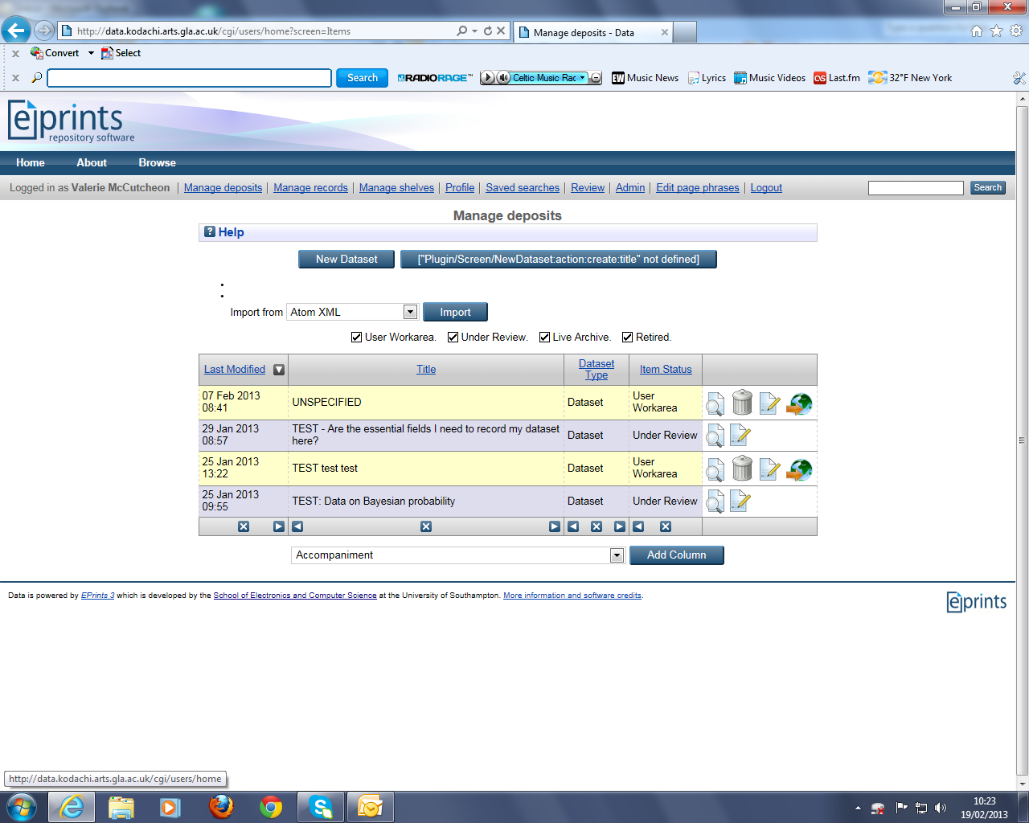
فهرس GU للبيانات البحثية
Notes:
Example of the data registry being developed at Glasgow.

Slide 29
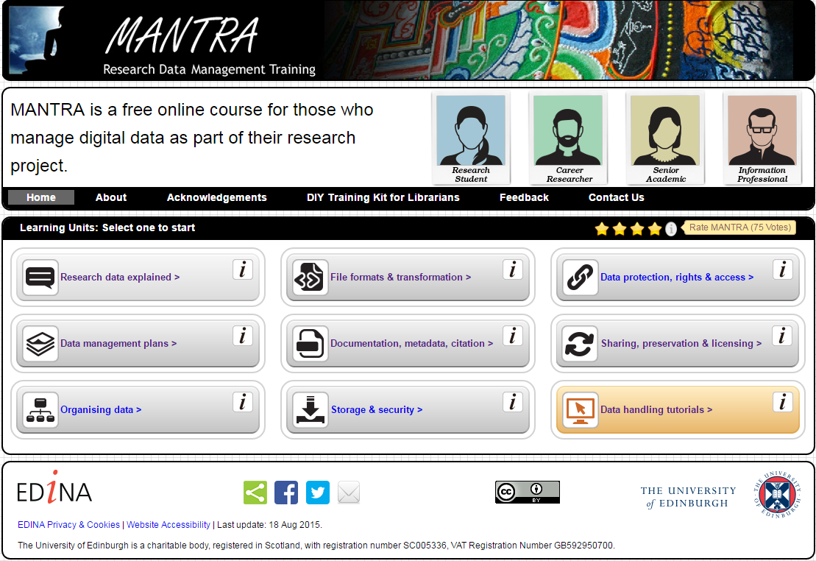
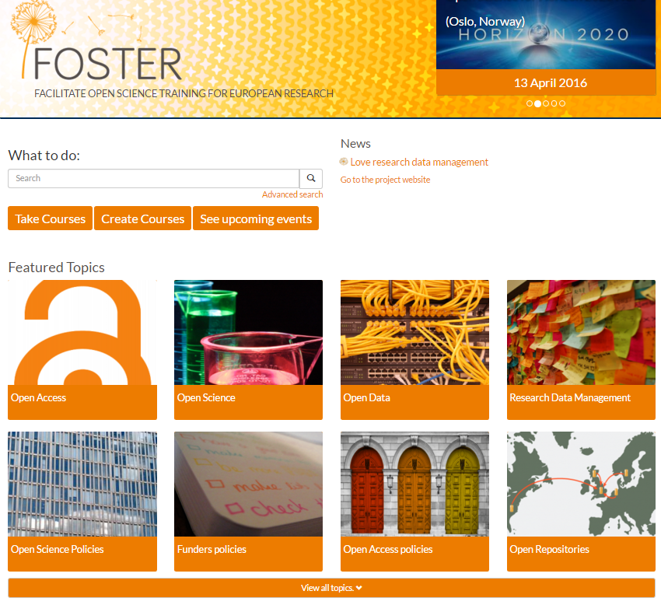
توجيه وتدريب
http://datalib.edina.ac.uk/mantra/
https://www.fosteropenscience.eu/
Notes:
Remember to underpin your policy with guidance and training. The best systems and policies in the world are useless if researchers don’t know how and when to use them!
Make online training easily available – try to post support pages in places researchers can find them and pitch the guidance at the right level. At the University of Glasgow, the Incremental project pulled together details of existing support available. We included contact details so there were no dead ends.
In most cases, there will be a lot of existing guidance and support materials that can be adapted rather than creating new guidance from scratch. There are many examples of guidance and training – most are Creative Commons licensed so you can repurpose them.
New RDM Collection within Jorum.

Slide 30
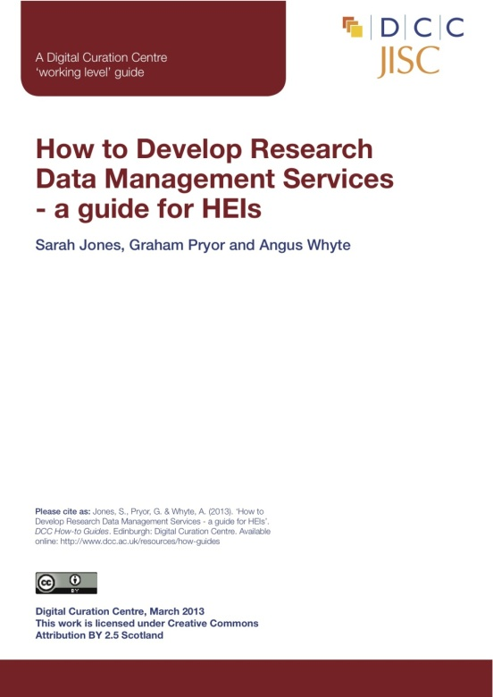
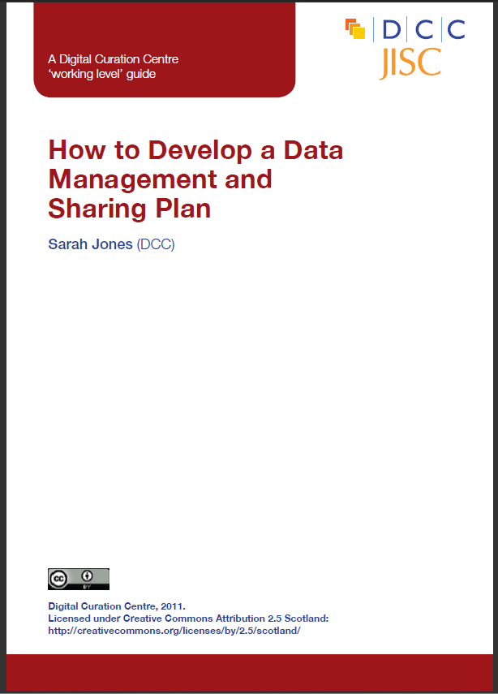
يوفر DCC توجيه و أمثلة و أدوات تساعد على الامتثال
http://www.dcc.ac.uk/resources
Notes:
Hopefully you’ve got a better idea of what might need to be considered when developing and implementing RDM policies within your institution.
The Digital Curation Centre and the Jisc MRD projects have produced a lot of guidance and support materials and we encourage you to make use of these and to feed back any additional resources that may be needed.
On the training event webpages, you see links to lots of relevant DCC and external resources, tools and guidance.

Slide 31
ملخص
من الممكن أن تساعد السياسات على الحصول على دعم من الإدارة العليا (وقت، تمويل)
من المهم تحديد نطاق السياسات
التشاور مع :
الجهات المتوقع امتثالها للسياسة
الجهات التي ستدعم تنفيذ السياسات والاشراف عليها
حاول أن تأخذ بعين الاعتبار آراء الآخرين حول ما يمكن تطبيقه قبل تبني السياسات في المؤسسة ( حاول قدر الإمكان الحصول على معلومات تتعلق بالتكاليف)

Slide 32
لا تبقى الأمور كما هي
http://www.independent.co.uk/news/world/americas/donald-trump-us-president-wins-lose-popular-election-hillary-clinton-3-million-votes-russia-hacking-a7535701.html
Image: http://webmaths.files.wordpress.com/2013/02/challenges.jpg
https://www.liberal.ca/
Notes:
Policies are not write once, leave forever!
Governments come and go, priorities change and the policies you develop will need to be reviewed and updated as things evolve. Policies should be specific enough to support requirements yet flexible enough to be adaptable as things change. Not always possible but best to avoid too much detail in policy that is unnecessary.
Was going to use Torry governemnt victory as an example, but this Canadian example is much more cheerful!
32

Slide 33
تمرين جماعي ( 20 دقيقة مع وقت إضافي لاستعراض آراء المشاركين)
بعد الاطلاع على الأوراق التي تم توزيعها عليكم، يرجى الإجابة على الأسئلة التالية ضمن مجموعات صغيرة (3-4 اشخاص)
هل تتماشى السياسة مع بيئة العمل في مؤسستك؟ إذا كان الجواب لا، فلما؟
هل هناك أية سياسات يجب أخذها بعين الاعتبار عند تطوير السياسة المحلية لإدارة البيانات ومعالجتها؟
بناء على طبيعة بيئة العمل الخاصة بمؤسستك، ما هي الخدمات والبنية التحتية اللازمة لتمكين الامتثال لمثل هذه السياسات؟
هل تعتقد بأنك ستواجه بعض من التحديات المتعلقة بتنفيذ هذه السياسات والاشراف عليها؟

